Slide 1
Chain Of Responsibility Design Pattern
A Behavioral Design Pattern

Slide 2
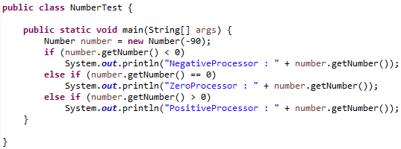
Problem

Slide 3
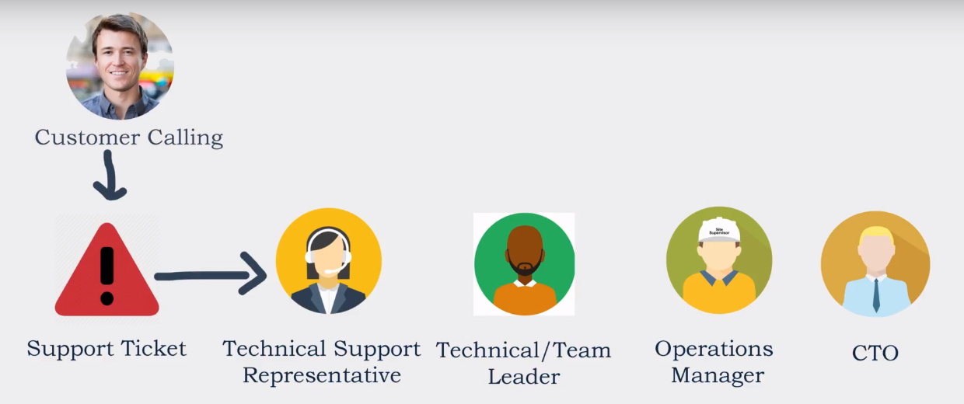
Solution

Slide 4
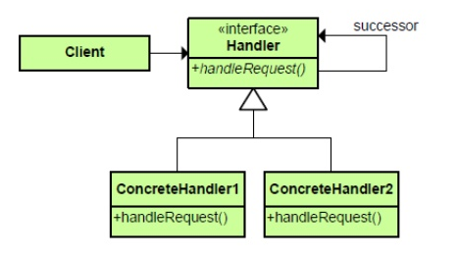
Class Diagram

Slide 5
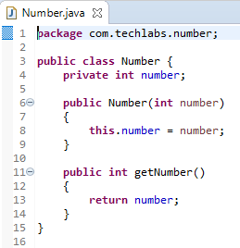
Custom Number Class

Slide 6
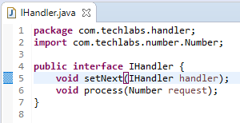
Handler Interface

Slide 7
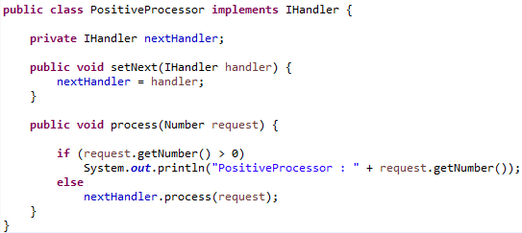
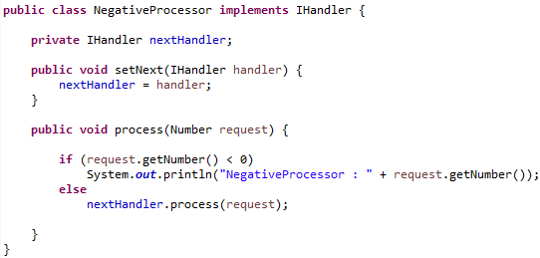
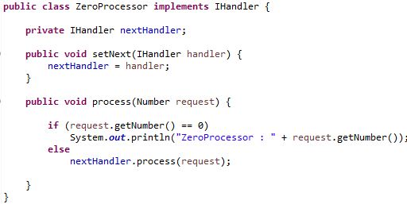
Concrete Classes

Slide 8
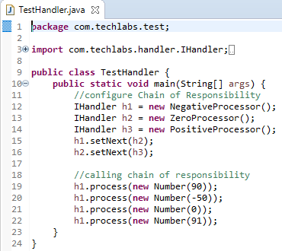
Testing

Slide 9

Output

Slide 10
Thank You

